Slide 1
Jackson Prep Mid Season Analytics Report
Director of Basketball Analytics – Andrew Purvis

Slide 2
Report Overview
01 | Overview of Team Stats
02 | Weekly Breakdown of Shooting % and AST, TOs, and REBs
03 | Stats for Wins and Losses
04 | Player Specific Breakdowns
05 | Additional Recommendations

Slide 3
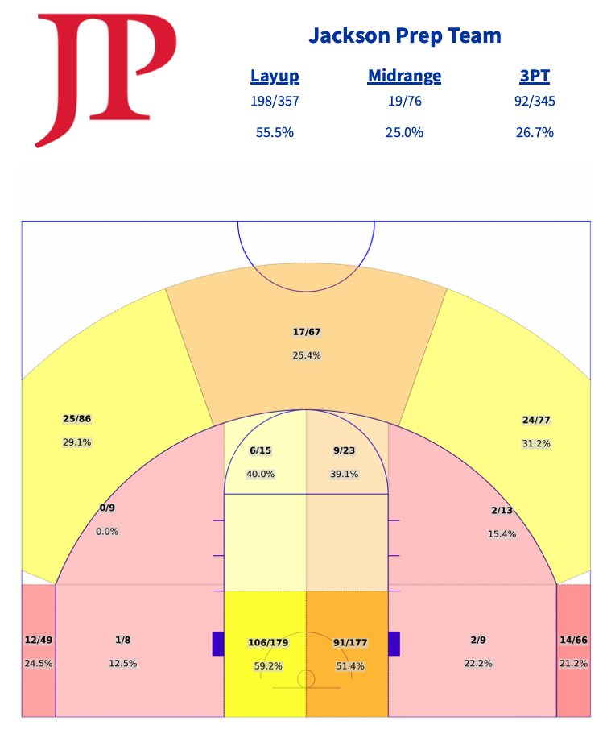
Game Stats
Close to the Basket (Layups)
Total FG% = 55.5%
Right Side = 59.2%
Left Side = 51.4%
Goal % = 60%
Midrange
Total FG% = 25%
Outside Paint = 12.8%
Paint Midrange = 39.4%
3PTs
Total FG% = 26.7%
Goal % = 40%
Goal FG% = 33%
Top Key % = 25.4%
Wing % = 30.1%
Corner % = 22.6%

Slide 4
Game Stats
Takeaways
Close to the Basket (Layups)
xPoints per Shot = 1.11
Midrange
xPoints per Midrange = 0.5
3PTs
xPoints per 3PT = 0.801
Weakness: Left Side at 51.4%
Weakness: Outside Paint Area
Weakness: Corners + Top of Key

Slide 5
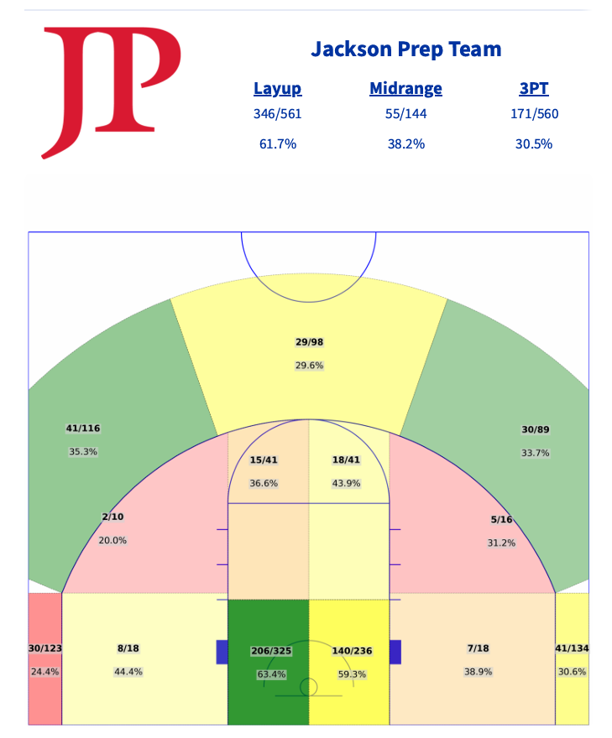
Practice Stats
Close to the Basket (Layups)
Total FG% = 61.7%
Right Side = 63.4%
Left Side = 59.3%
Goal % = 60%
Midrange
Total FG% = 38.2%
Outside Paint = 35.5%
Paint Midrange = 40.2%
3PTs
Total FG% = 30.5%
Goal % = 40%
Goal FG% = 33%
Top Key % = 29.6%
Wing % = 34.6%
Corner % = 27.6%

Slide 6
Practice Stats
Takeaways
Close to the Basket (Layups)
xPoints per Shot = 1.23
Midrange
xPoints per Midrange = 0.76
3PTs
xPoints per 3PT = 0.915
Weakness: -4% from Left Side to Right Side (Confirms Game)
Weakness: Wing Midrange
Weakness: Right Corner + Top of Key (Confirms from Game Stats)
Outside Paint: Better % than Game

Slide 7
Overall Takeaways – Shooting %
Decent decrease from Practice % to Game %
Practice Faster than Game Speed
Being Uncomfortable in Practice will help Increase Comfort in Games
Shots around the rim
Do NOT expect a foul, finish through contact
Limit Midrange attempts
Lowest xPoints out of 3 types of shots
3PT Attempts
Ready Stance to Shoot will decrease Contest % from opponents

Slide 8
Weekly Breakdown – Team Shots near Rim

Slide 9
Weekly Breakdown – Team Midrange %

Slide 10
Weekly Breakdown – Team 3PT Attempts

Slide 11
Weekly Breakdown – Team Ast/TO Ratio

